Slide 1

TOKYO INTERNATIONAL UNIVERSITY
PYTHON FOR DATA SCIENCE
TREND ANALYSIS OF HATE CRIMES IN THE US
27 OCTOBER, 2026
-------------------------------------------------------------
Lancelot Tabiaat - Adiya Koblandy - Toan

Slide 2
ANALYSIS OF HATE CRIMES IN THE US
-------------------------------------------------------------

Slide 3


INTRODUCTION
Hate crime Data Investigation using the FBI crime data explorer (CDE) API.
Goal: Pattern and Relationship Identification between hate crime types, offender demographics, and time trends.

Slide 4


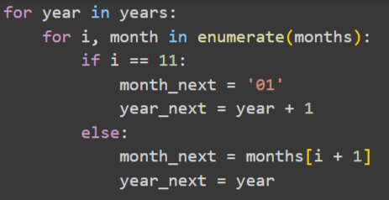
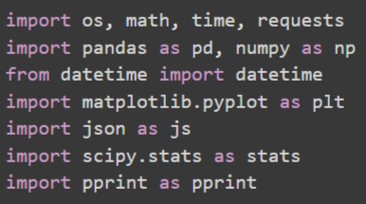
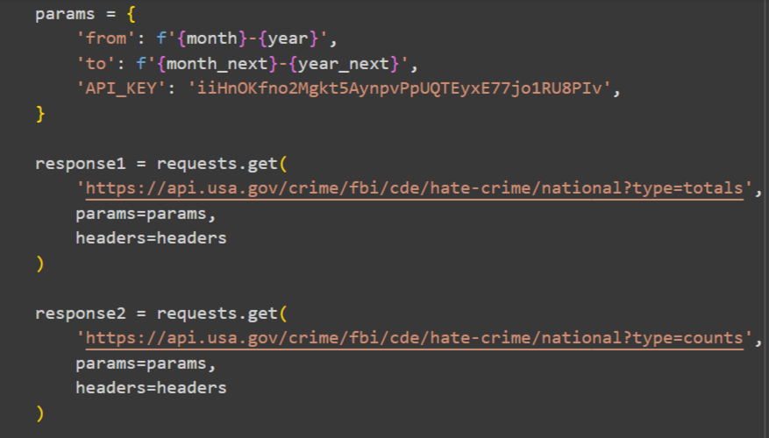
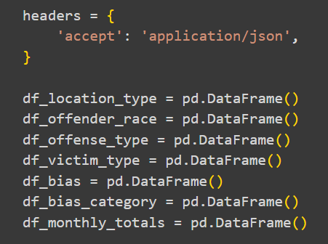
DATA COLLECTION & CLEANING
Necessary Libraries
Automated Data Collection Loop (1995-2024)
Data to collect

Slide 5
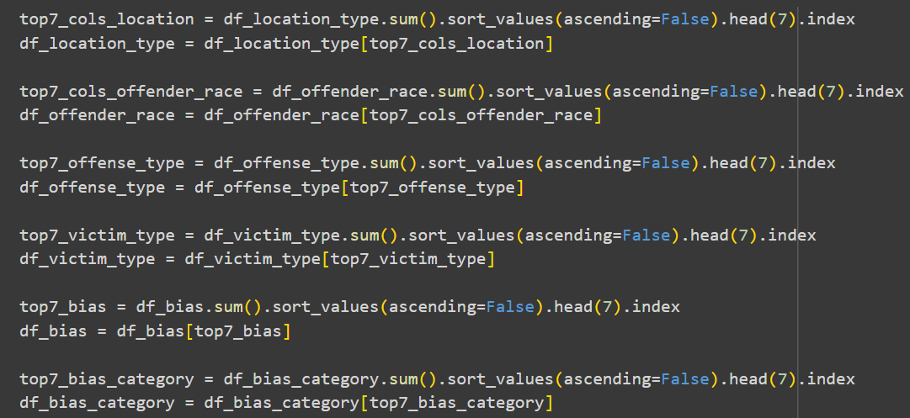
DATA COLLECTION & CLEANING
Top 7 Hate Crime Categories by Frequency

Slide 6


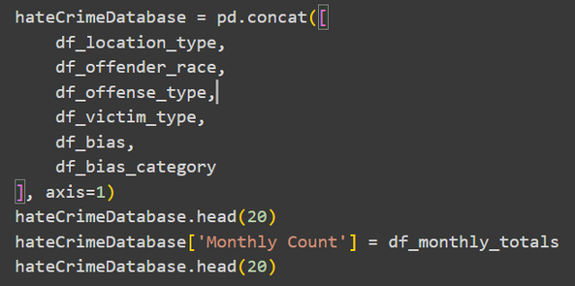
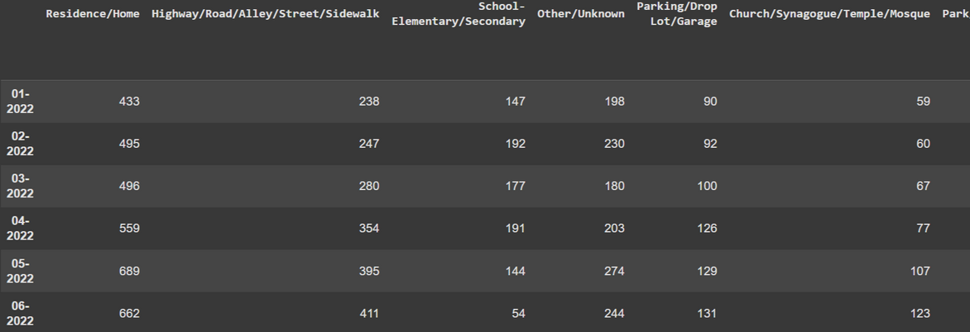
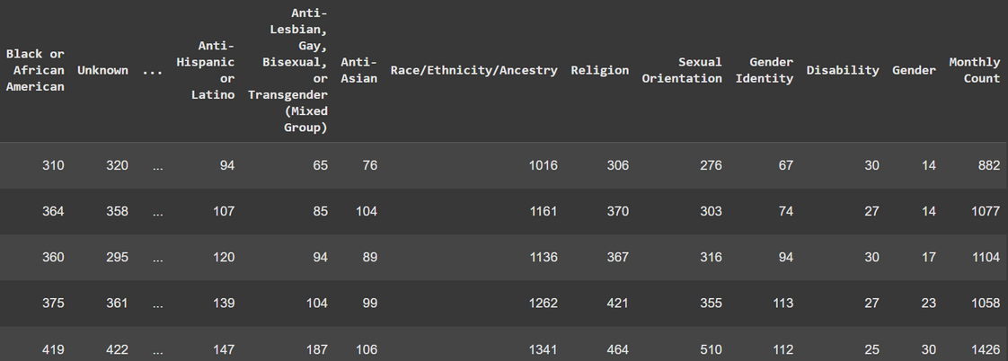
EXPLORATORY DATA ANALYSIS
Creating a Hate Crime Database
Combined 6 key datasets into one master DataFrame
Added monthly total counts as a reference column
Prepared a clean, unified table for further statistical analysis

Slide 7
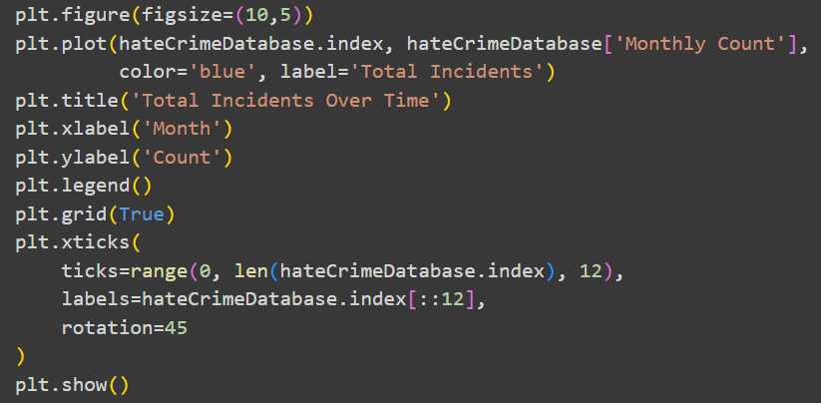

EXPLORATORY DATA ANALYSIS
Created a line chart showing the total number of hate crimes per month.
The plot reveals how hate crimes fluctuate over time, showing visible ups and downs rather than a flat trend.
Serves as an overview before testing the hypotheses.
Trend of Total Hate Crime Incidents Over Time

Slide 8
Question for the Audience
Why do you think there are spikes in the following graph on the next page?

Slide 9
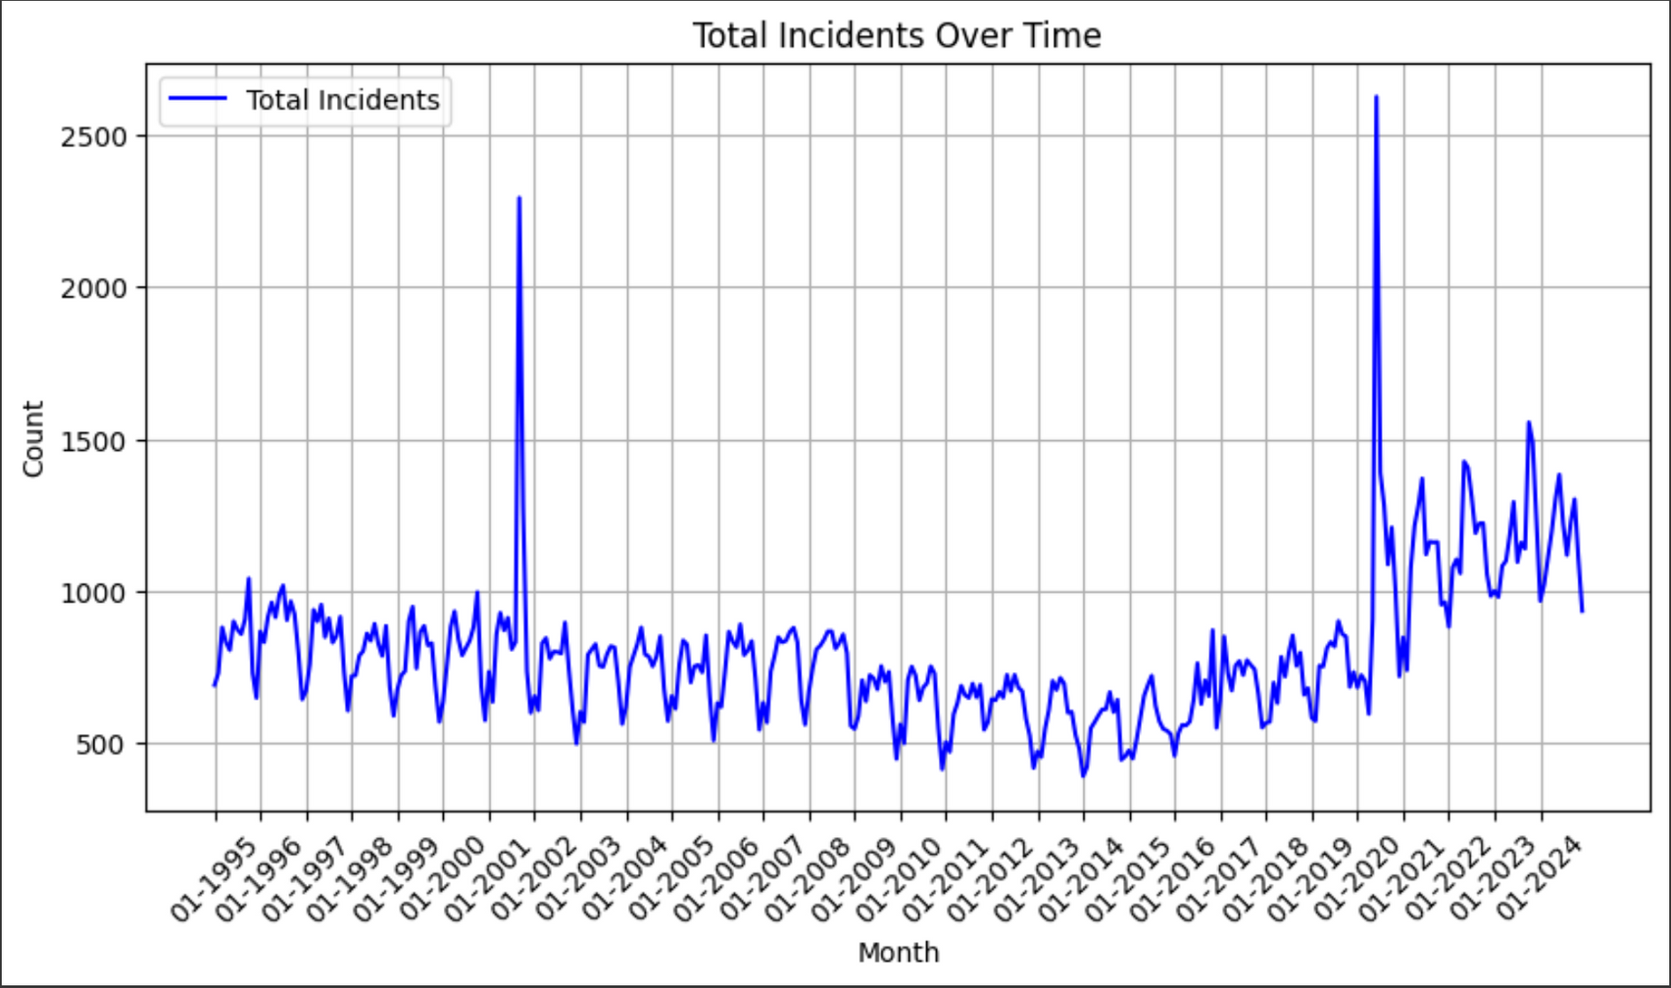
EDA

Slide 10
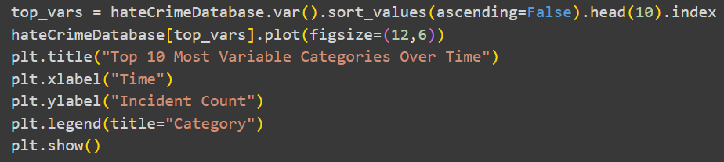
Top 10 Most Variable Hate Crime Categories Over Time
EDA
Calculated variance for every hate-crime related column.
Selected the top 10 categories with the greatest month-to-month changes.
Plotted them to observe which types of hate crimes show the most volatility.
Reveals dynamic categories where hate incidents rise or fall sharply over time.

Slide 11
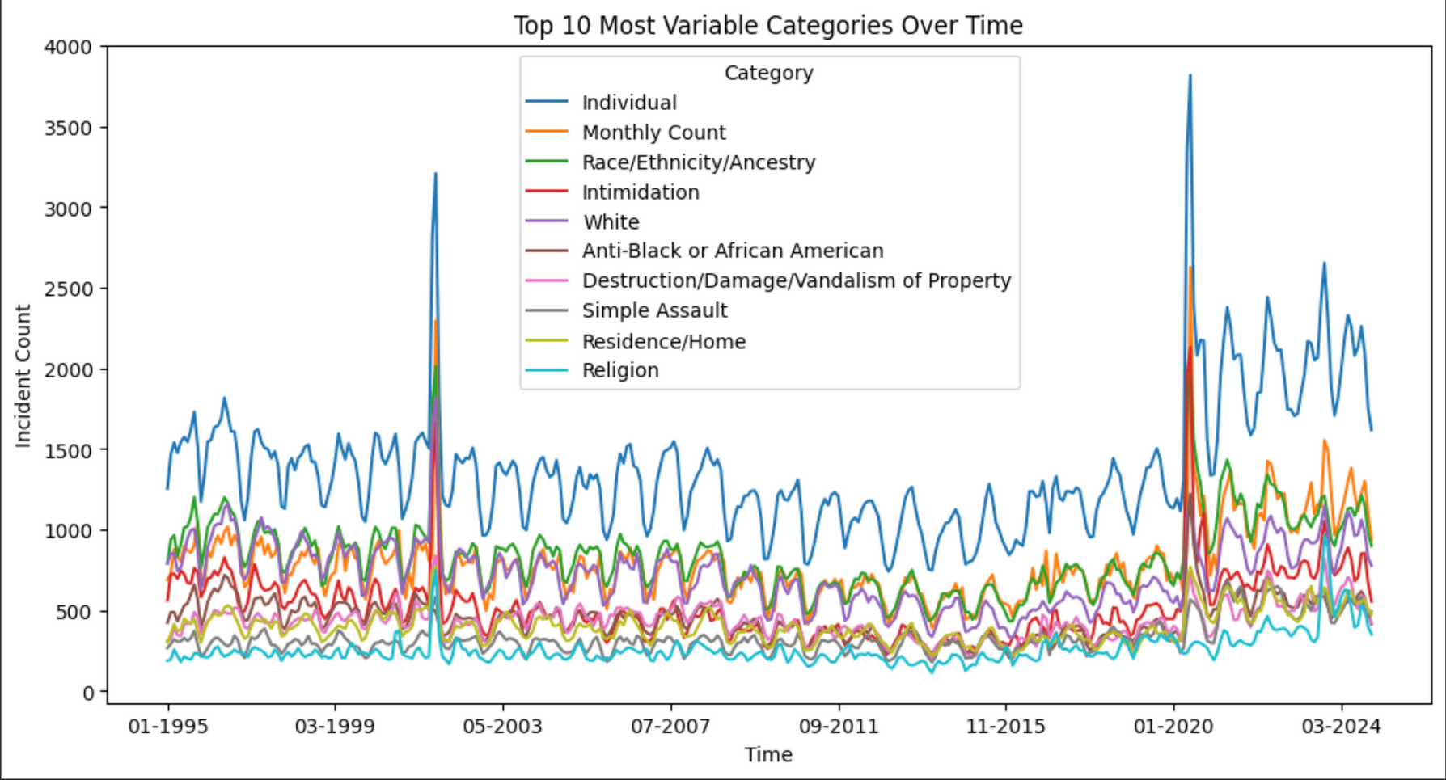
EXPLORATORY DATA ANALYSIS

Slide 12

RESEARCH QUESTION 1
Research question: How does the frequency of hate crimes between racial or ethnic groups in the US differ over time.
Null Hypothesis (H₀): There is no significant difference in the frequency of hate crimes among different racial or ethnic groups over time.
Alternative Hypothesis (H₁): There is a significant difference in the frequency of hate crimes among different racial or ethnic groups over time.

Slide 13

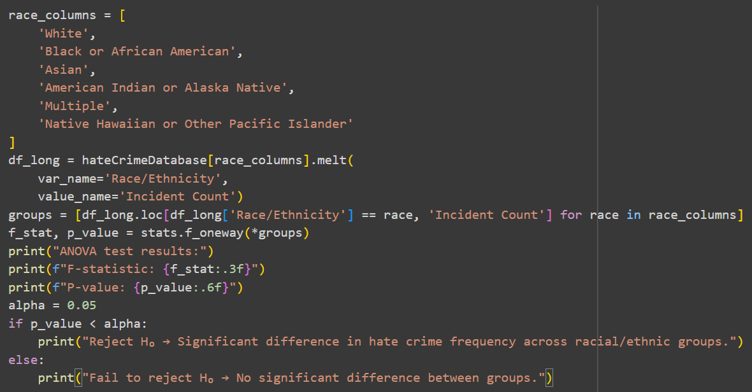
ANOVA
ANOVA test results:
F-statistic: 3665.100
P-value: 0.000000
Reject H₀ → Significant difference in hate crime frequency across racial/ethnic groups.

Slide 14
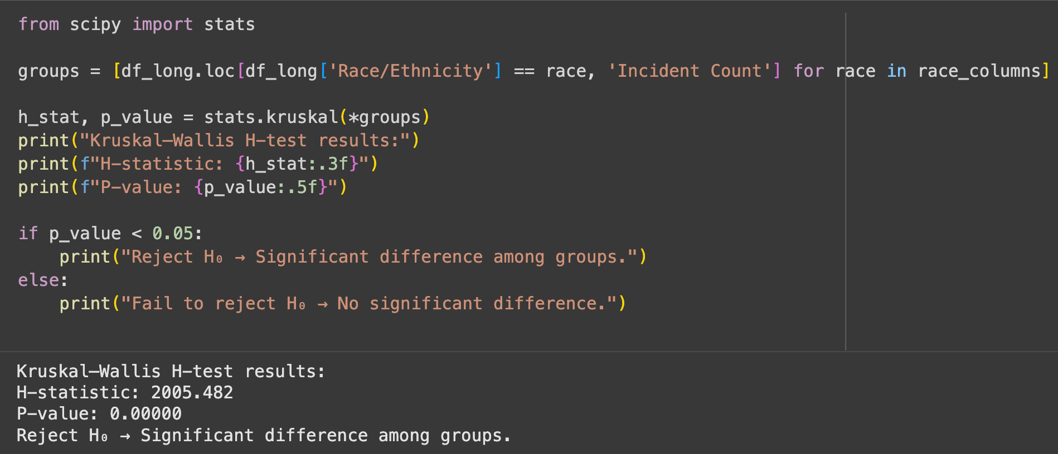
KRUSKAL WALLIS TEST
Similar to ANOVA but it doesnt assume a normal distribution, which is safer for our data set seeing as its a count based dataframe.

Slide 15

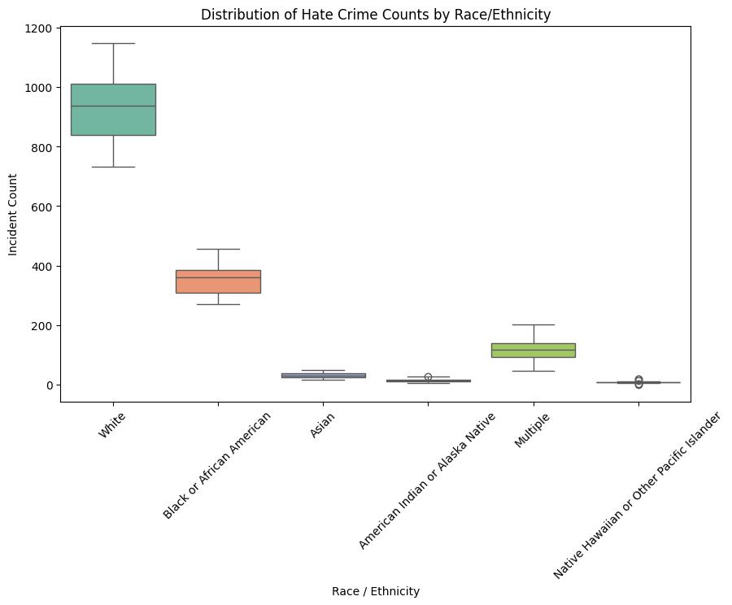
VISUALIZATION WITH BOX PLOT
White: highest median and widest spread, consistently high counts with large variability.
Black or African American: second-highest median; moderate spread.
Multiple: mid-level counts but quite variable (long whiskers).
Asian and American Indian or Alaska Native: low medians, relatively tight spread.
Native Hawaiian or Other Pacific Islander: lowest counts overall.

Slide 16
RESEARCH QUESTION 2
Research Question: How does the relationship between intimidation and aggravated assault change over time?
Null Hypothesis (H₀): There is no correlation between intimidation and aggrevated assault over time.
Alternative Hypothesis (H₁): Increases in intimidation hate crimes also leads to increases of aggravated assault over time.

Slide 17
Question for the Audience
Are words just words, or do you think words are a precursor for action?

Slide 18

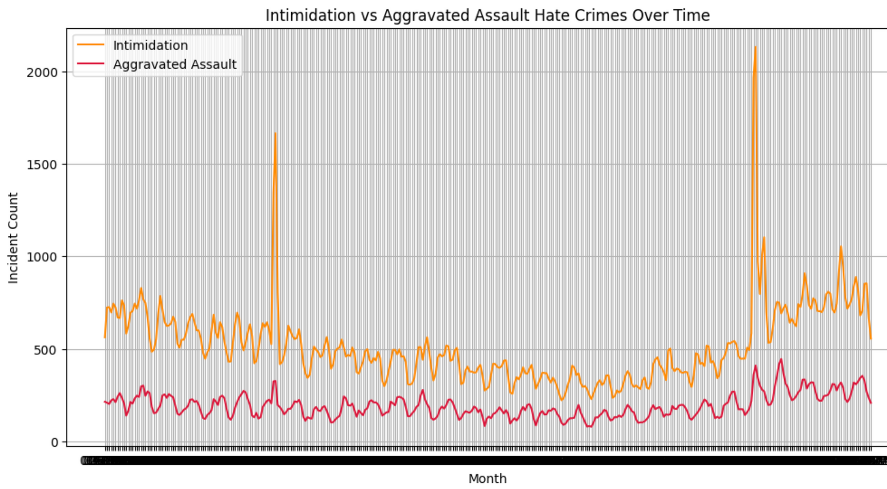
INTIMIDATION VS AGGRAVATED ASSAULTS: MONTHLY TRENDS
Both series rise and fall in broadly similar periods.
Intimidation is much larger in magnitude;
aggravated assault tracks the ups/downs with a smaller amplitude.

Slide 19

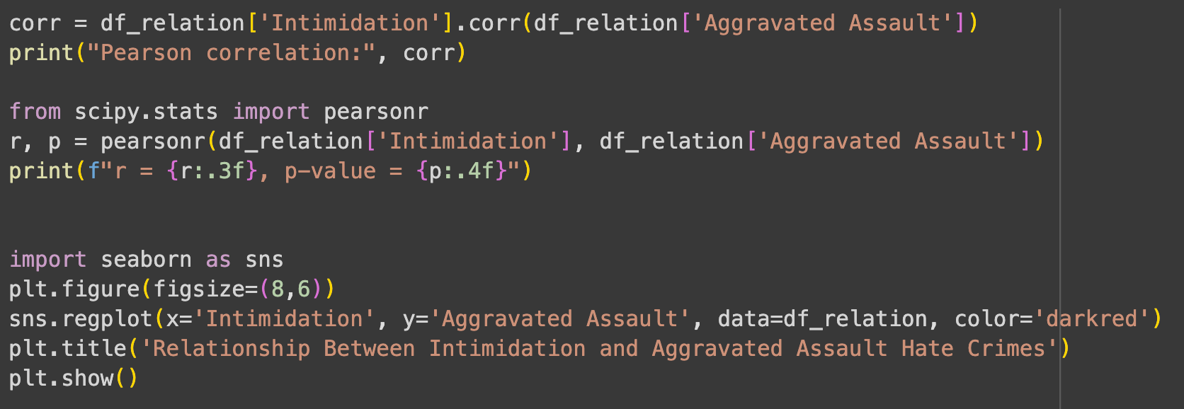
CORRELATION BETWEEN INTIMIDATION AND AGGRAVATED ASSAULTS
r = 0.764, p-value = 0.0000
Reject Null Hypothesis (H₀): There is no correlation between intimidation and aggravated assault over time.

Slide 20
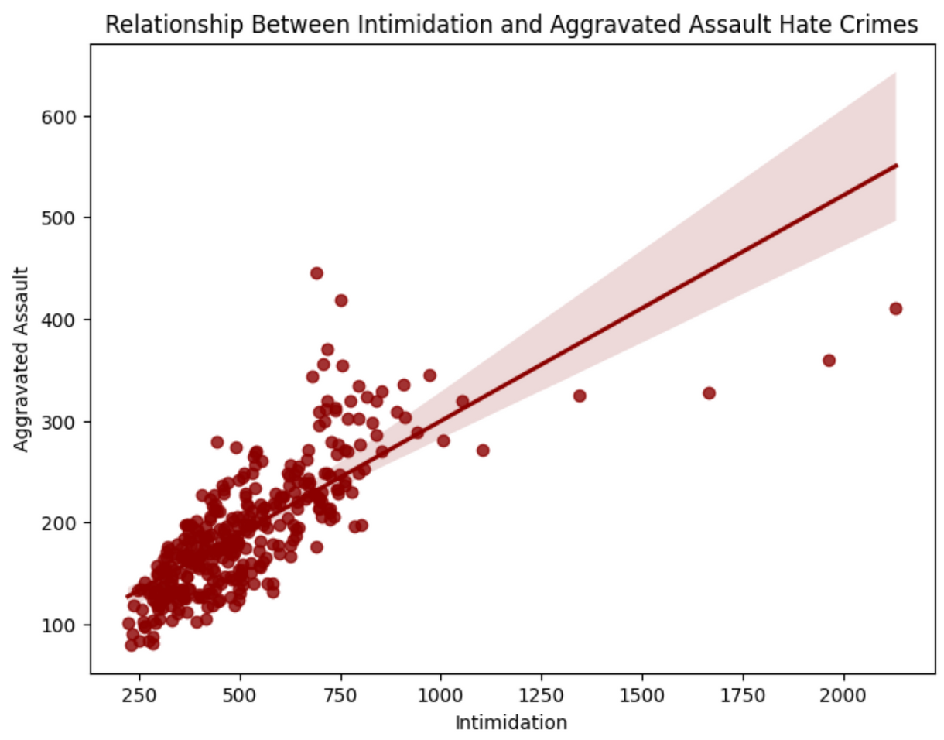
CORRELATION BETWEEN INTIMIDATION AND AGGRAVATED ASSAULTS
Upward trend: The scatter shows a clear positive slope.
Pearson’s r ≈ 0.76 → strong positive association.
Significance: p ≈ 0.000 (< 0.05) → reject H₀
Months with higher Intimidation tend to coincide with higher Aggravated Assault counts.

Slide 21
RESEARCH QUESTION 3
Research Question: Has the overall number of reported hate crimes fluctuated significantly, indicating temporal or seasonal trends?
Null Hypothesis (H₀): The number of hate crimes has remained stable over time, showing no significant temporal or seasonal variation.
Alternative Hypothesis (H₁): The number of hate crimes has varied significantly over time, showing clear temporal or seasonal fluctuations.

Slide 22
Question for the Audience
Do you think the number of hate crimes in the US in the past 30 years has increased or decreased?

Slide 23

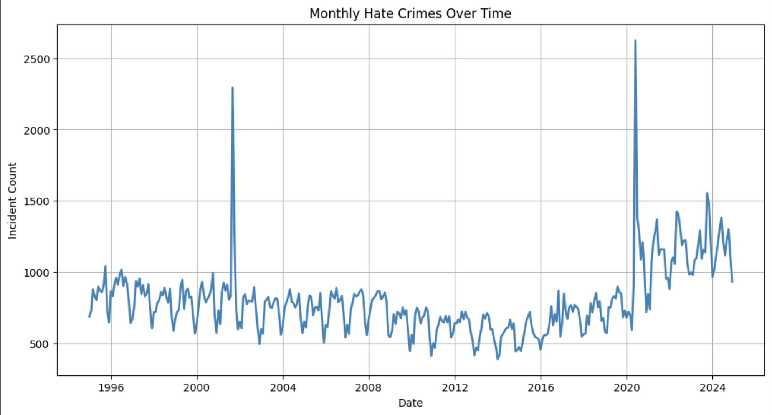

Slide 24
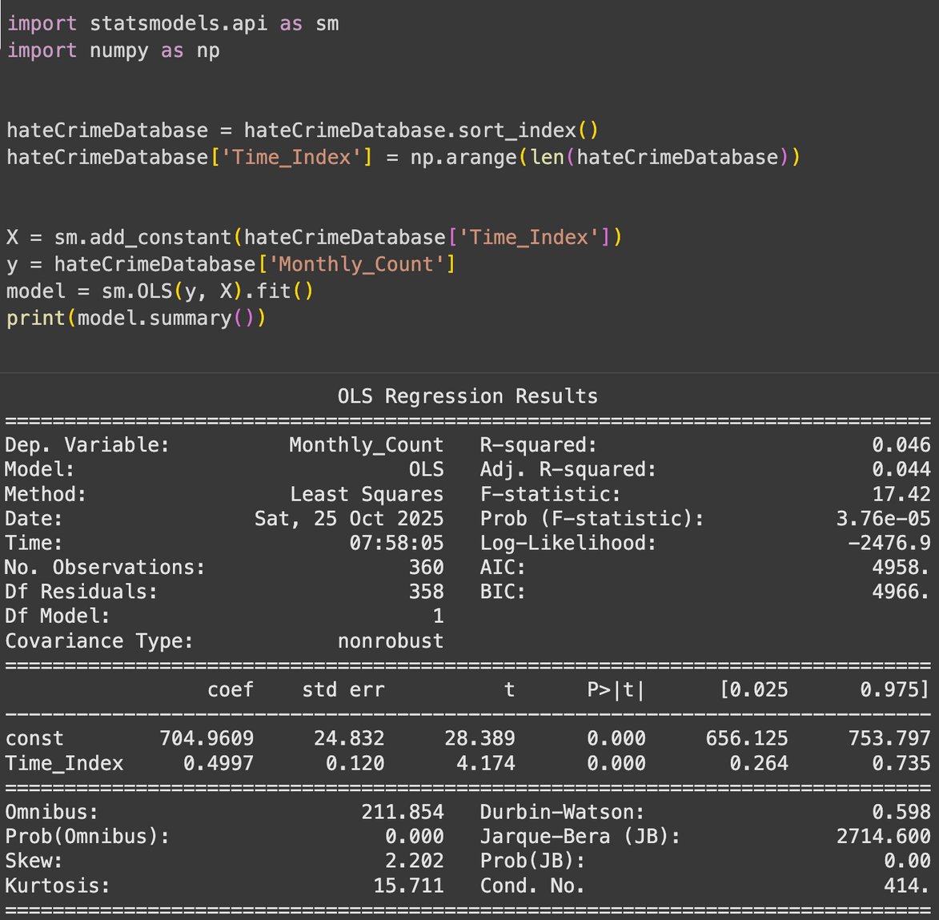
3.1 Linear Trend Analysis (OLS): Establishes overall upward trend in hate crimes.
R square = 0.46
F-statistic = 17.42
p = 3.76e-05
There is a small but statistically relevant increase in hate crimes over the past 30 years

Slide 25
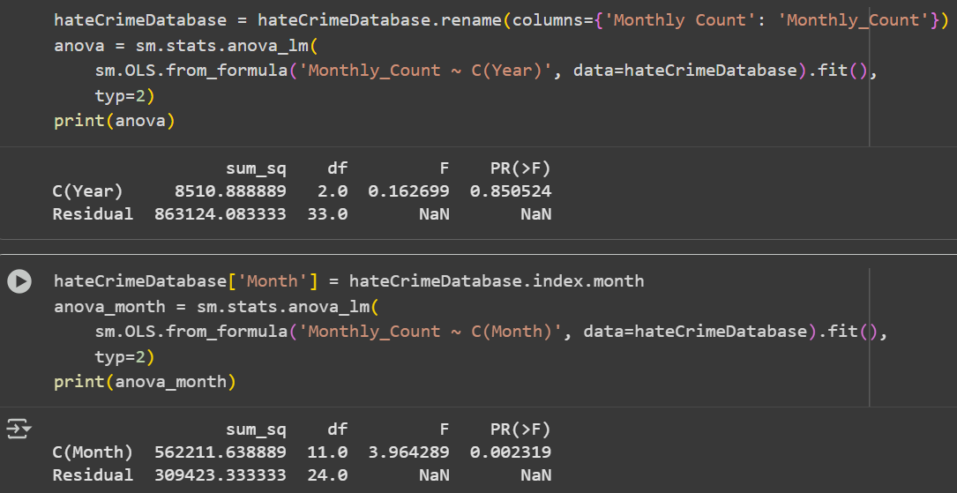
3.2 Temporal & Seasonal ANOVA: Tests yearly and monthly differences, confirming significant fluctuations.

Slide 26
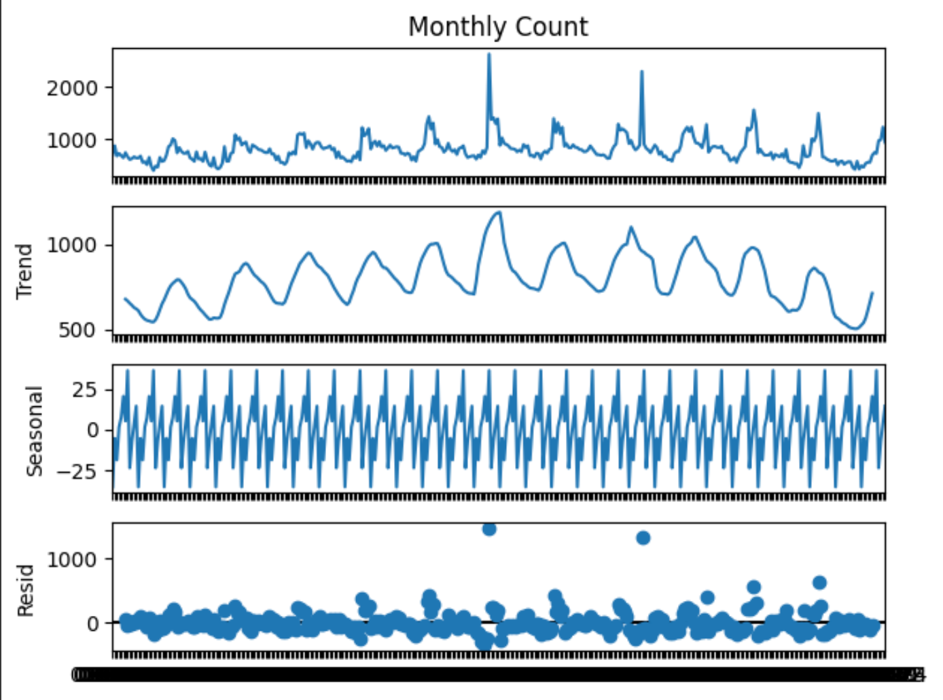
There’s a long-term upward trend (confirmed by OLS).
There are significant seasonal patterns (confirmed by ANOVA on months).
There are irregular spikes likely tied to major real-world events (reflected in residuals).

Slide 27
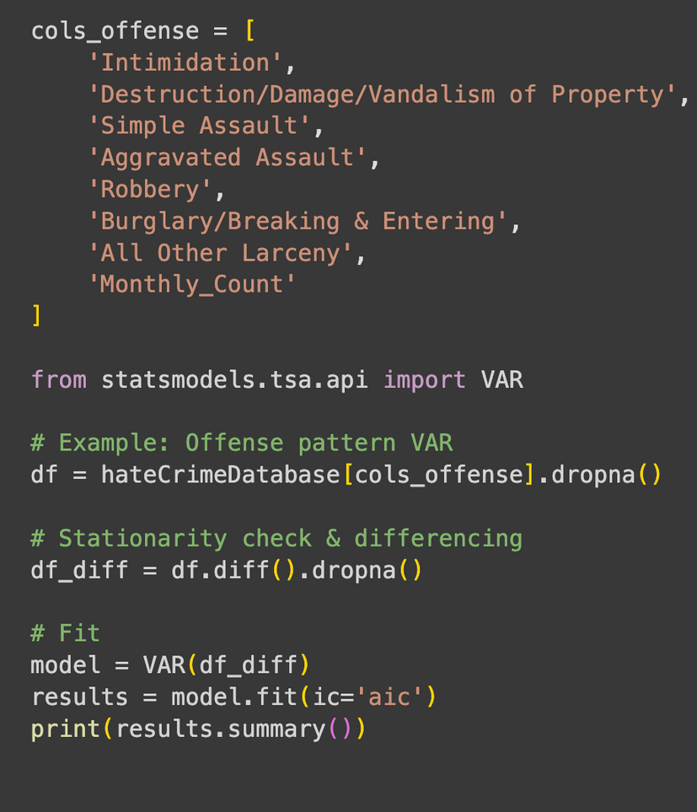
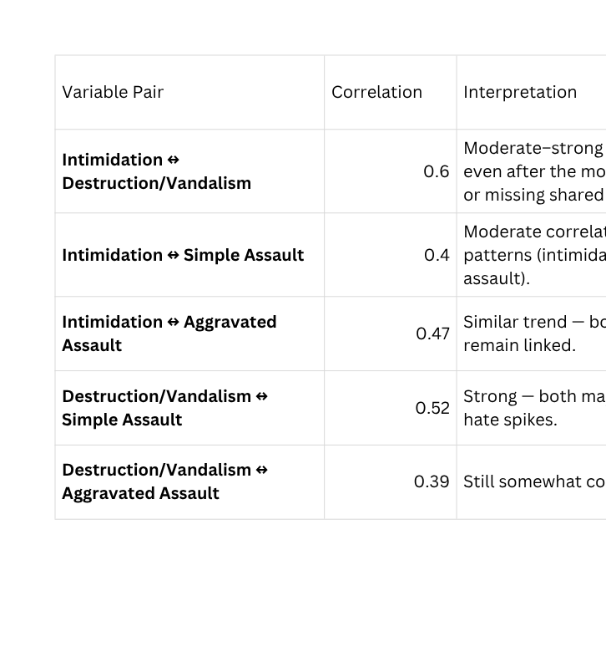
3.3 Multivariate Time-Series Modeling (VAR): Examines dynamic interrelationships between hate crime categories.
This model analyzes how multiple variables move together over time
The response is way too large to add to this presentation, but we added the final matrix correlation for useful insights.

Slide 28
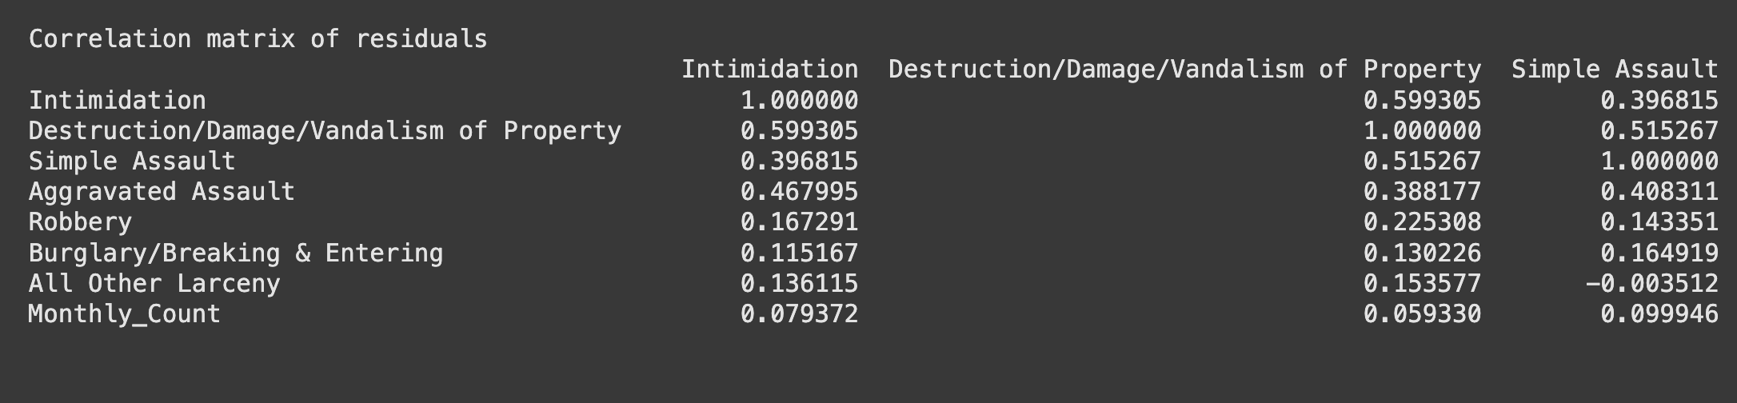


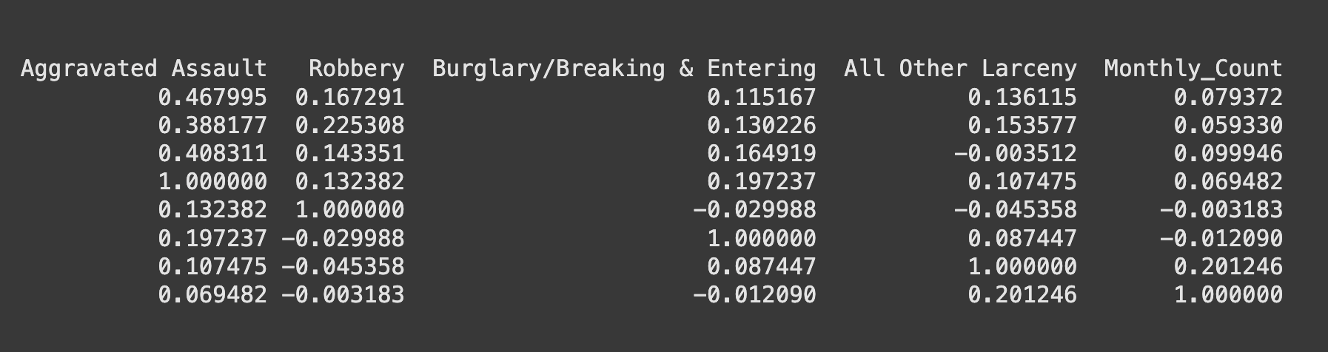

Slide 29
POSSIBLE IMPROVEMENTS AND IMPLICATIONS
1) Add current affairs and social data to try to explain gaps not explained by models.
2) Include more data points over more years to improve accuracy
3) Remove seasonality to understand relationships between variables more clearly
1) Hate crimes are a persistent and growing social issue, and policymakers should continue to push to solve this issue
2) Future studies should incorporate external variables.

Slide 30
CONCLUSION
RSQ1: Reject H₀ which says that there is a significant difference in hate crime frequency across racial/ethnic groups.
RSQ2: Reject Null Hypothesis (H₀), so it means that there is correlation between intimidation and aggravated assault over time.
RSQ3: Reject Null Hypothesis (H₀) which means the number of hate crimes has varied stable over time, showing no significant temporal or seasonal variation.

Slide 31
REFERENCES
Federal Bureau of Investigation. (n.d.). Crime Data Explorer (CDE). U.S. Department of Justice. Retrieved October 25, 2025, from https://cde.ucr.cjis.gov/
Federal Bureau of Investigation. (2023). Uniform Crime Reporting (UCR) Program. Retrieved from https://www.fbi.gov/how-we-can-help-you/more-fbi-services-and-information/ucr
Federal Bureau of Investigation. (2023, February 8). Privacy Impact Assessment for the Uniform Crime Reporting (UCR) System. U.S. Department of Justice. Retrieved from https://www.fbi.gov/file-repository/pias/pia-uniform-crime-reporting-system-020823.pdf
Federal Bureau of Investigation. (n.d.). Hate Crime Statistics Program Methodology. Retrieved from https://ucr.fbi.gov/hate-crime/2018/resource-pages/methodology

Slide 32
WE WANT TO SAY
THANK YOU
FOR YOUR ATTENTION

